Slide 1
Nico Aupke
Project management / support management
C.K. Solution
Nico.Aupke@cksolution.de

Slide 2
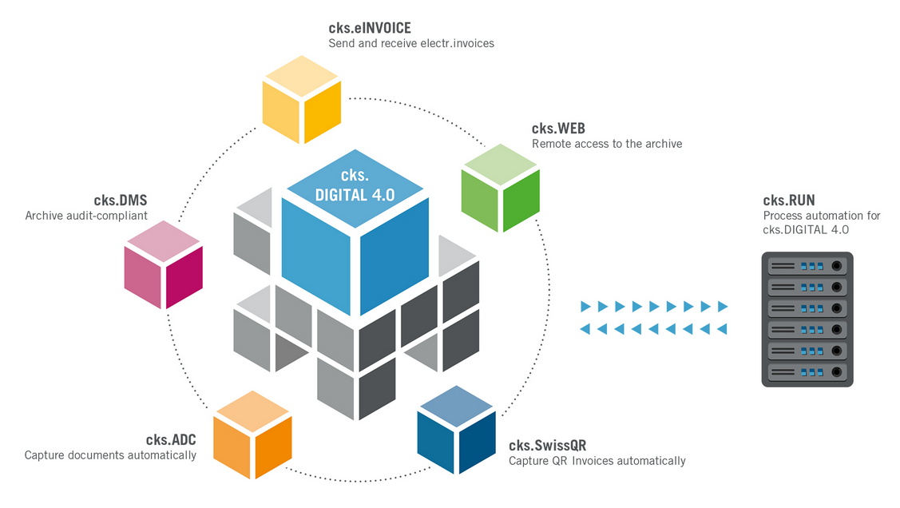
Course structure
The following structure:
- cks.DIGITAL 4.0
- cks.DMS
- cks.ADC
- cks.RUN
- cks.WEB
After that online course exam.

Slide 3
cks.WEB
Agenda cks.WEB:
Practical use
Requirements
Installation
Configuration cks.WEB > SAP approval procedure
Setup cks.WEB
Update cks.WEB

Slide 4
cks.WEB
Practical use:
Part 1:
Archive accessible from anywhere (web browser) for e.g. tax consultant / sales staff.
New versions of documents can be uploaded.
Part 2:
- SAP approval procedure without SAP B1 Client

Slide 5
cks.WEB
Prerequisite:
cks.DMS must be installed as of version 7.7.0.0
Pure document view / SAP approval process?
SAP approval procedure: At least 1 Indirect Access License
DNS name must be reachable (important for the certificate)
External port shares (Port: 5001 (http cks.WEB) / 5002 (https cks.WEB) / 5003 (http cks.API) / 5004 https cks.API) - NGINX ports
Internal port usage (port 5005 - communication NGINX > cks.API)
Webbrowser support: Google Chrome / Microsoft Edge / Mozilla Firefox

Slide 6
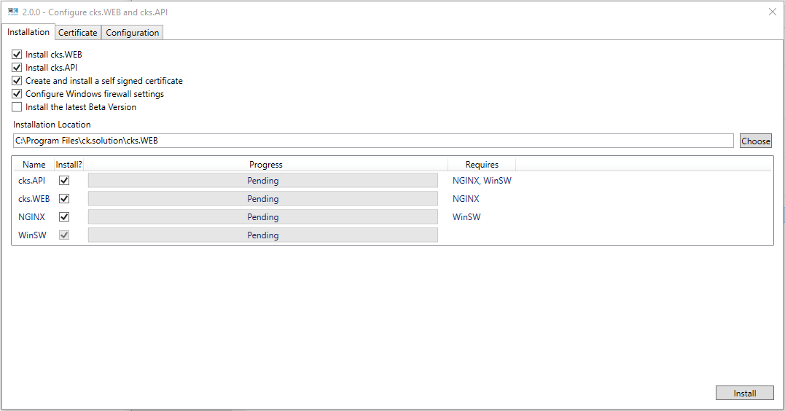
cks.WEB
Installation 1/4:
Download cks.WEB Admin Tool
Execute the cks.WEB.Admin.Tool.exe file

Slide 7
cks.WEB
Installation 2/4:
Which components should be installed?
Where should the program data be stored?

Slide 8
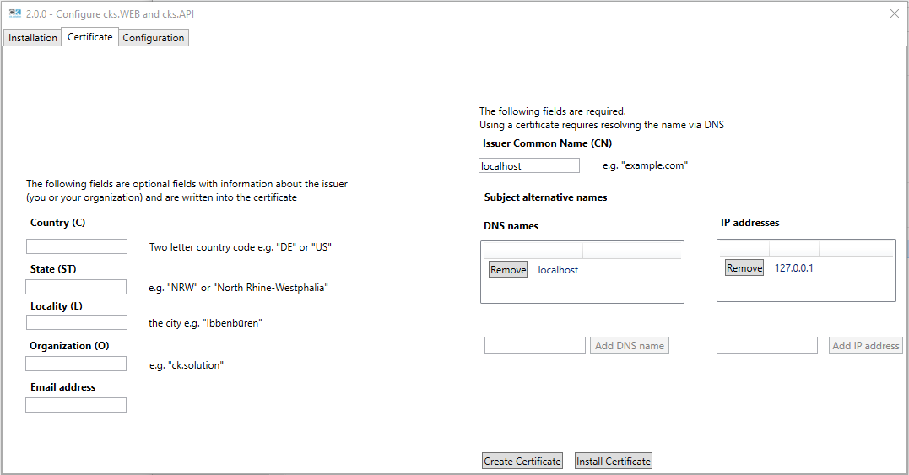
cks.WEB
Installation 3/4:
What type of certificate (HTTPS) to create?
Self-signed certificate (Like SAP)
Customer has own certificate

Slide 9
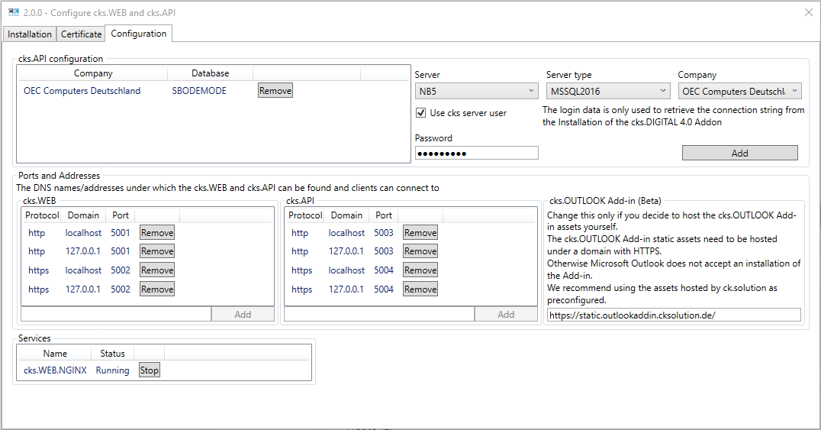
cks.WEB
Installation 4/4:
Linking SAP databases with the cks.WEB
Which domains / ports are relevant?

Slide 10
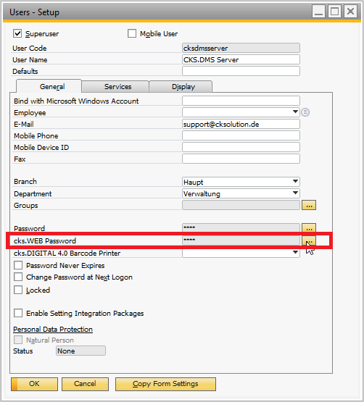
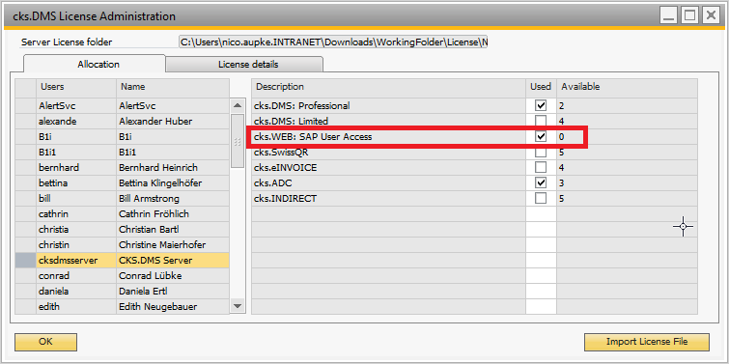
cks.WEB
Configuration (1/2):
cks.WEB User: Created + password assignment.
cks.WEB Licence
Administration > Licence > cks.DMS License Administration

Slide 11
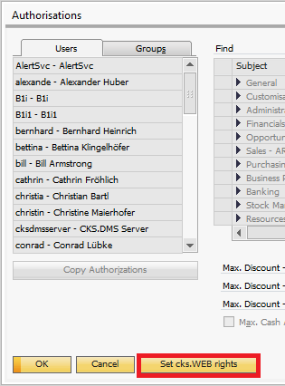
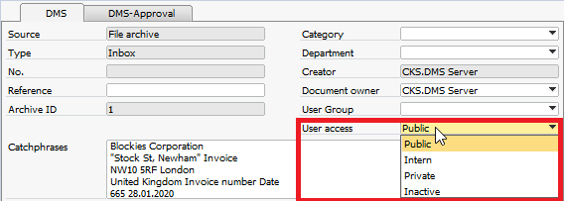
cks.WEB
Configuration (2/2):
cks.WEB Authorization 1:1 as coded in cks.DMS.
Sync. of the authorizations to cks.WEB
Administration > System Initialisation > Authorisations > Gen. Authorisations
3. Additional authorization cks.WEB

Slide 12
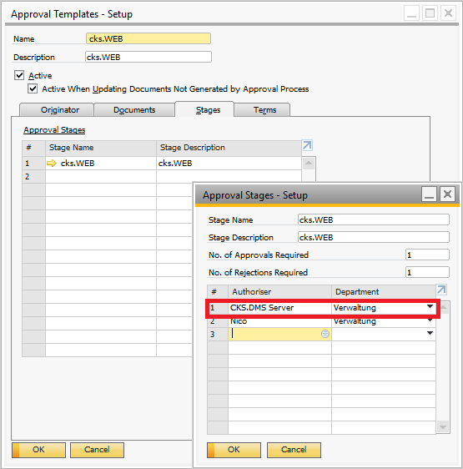
cks.WEB
SAP approval process:
cks.DMS Server has to be deposited as well
Indirect Access License is required at least.

Slide 13
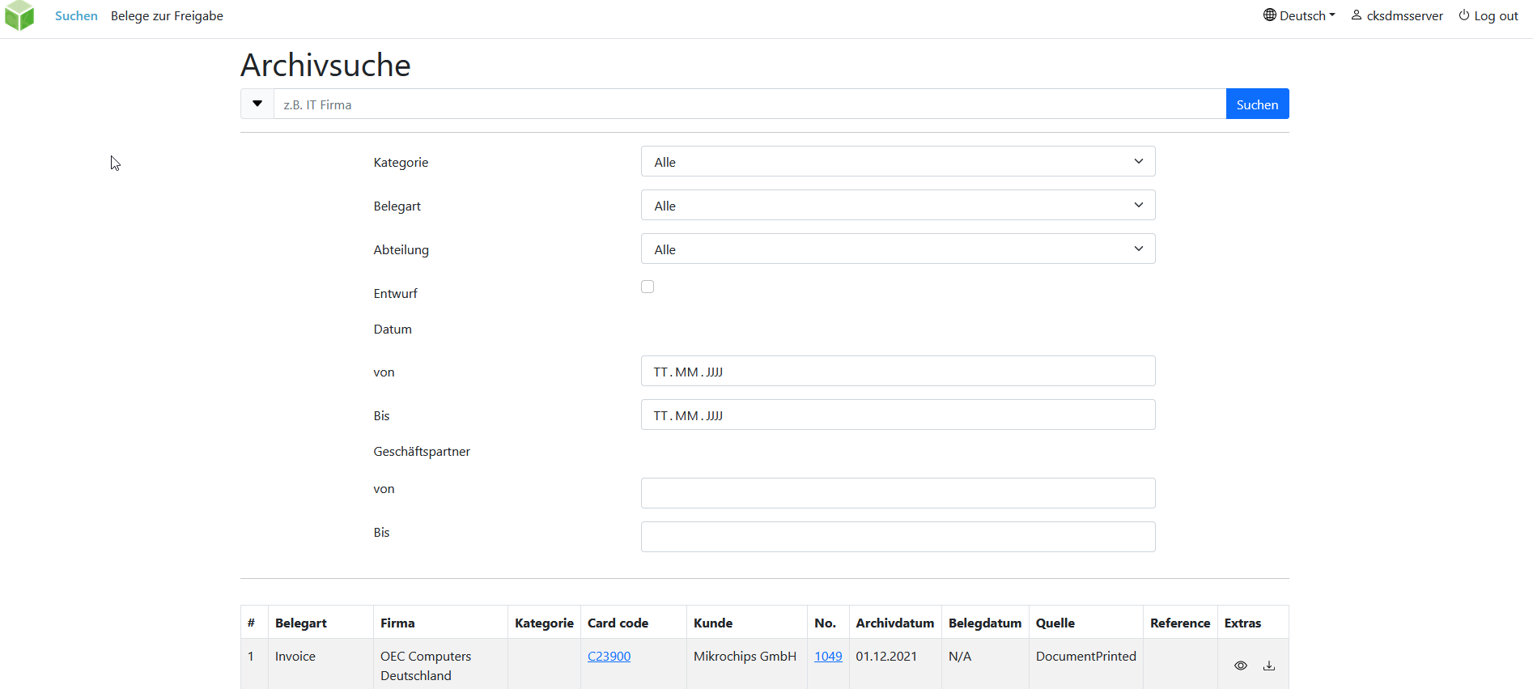
cks.WEB
Website Structure (1/2):
Archive view over the complete archive and filter option and search function via keywording.

Slide 14
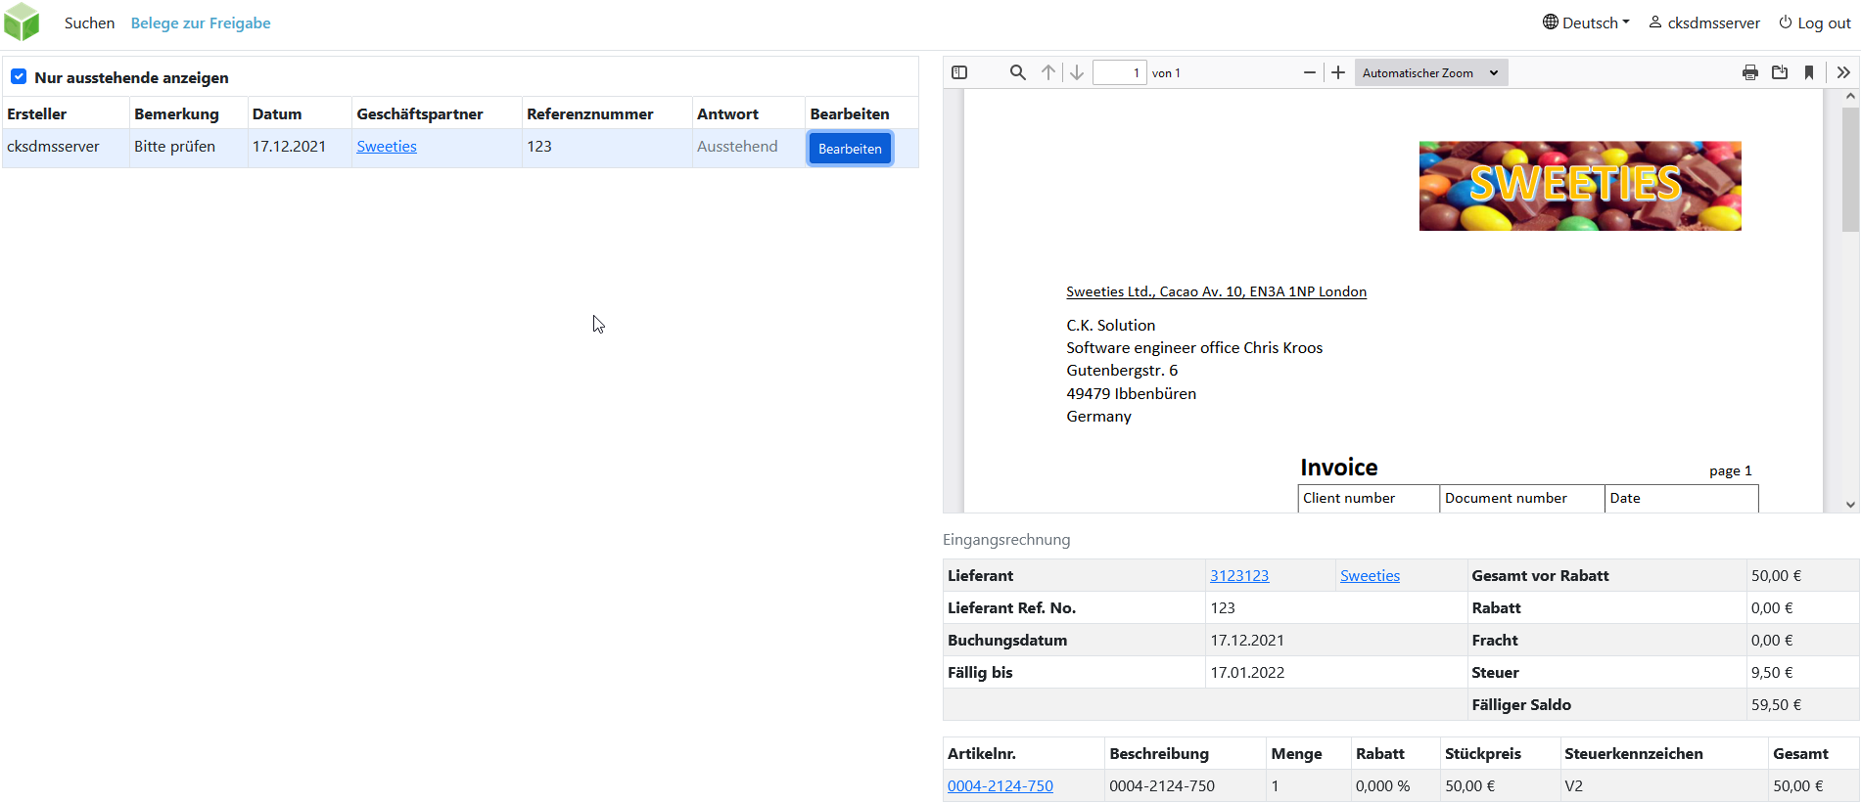
cks.WEB
Website Structure (2/2):
View of all approval procedures with archive preview and SAP master data.

Slide 15
cks.WEB
Update:
Download the latest version of the cks.WEB Admin Tool
Initiate install function again.
This will download and update the latest cks.WEB
This will download and update the latest cks.API
cks.WEB services are restarted automatically afterwards

Slide 16
Exam
Exam link :

