Slide 1
Nico Aupke
Project management / support management
C.K. Solution
Nico.Aupke@cksolution.de

Slide 2
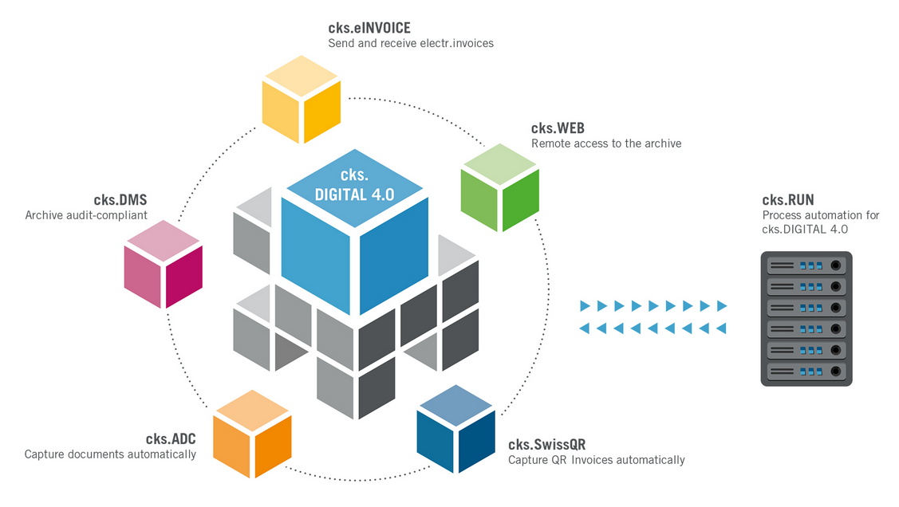
Course structure
The following structure:
- cks.DIGITAL 4.0
- cks.DMS
- cks.ADC
- cks.RUN
- cks.WEB
After that online course exam.

Slide 3
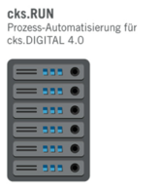
cks.RUN
Agenda cks.RUN:
Practical use
Requirements
Installation
Structure cks.RUN
Modules cks.RUN / Practical examples
Update cks.RUN

Slide 4
cks.RUN
Practical use:
Automation of processes (cks.DMS / cks.ADC / cks.eINVOICE)
Server controlled (load is not client side)
Time controlled processes
Cross-client configuration (tenants)

Slide 5
cks.RUN
Prerequisites:
Processes/ information for the modules should be clarified.
cks.DMS / cks.RUN version must match (dependencies)
Database login is required
Installation on Windows Server
Depending on the function other AddOns are required (Coresuite / cks.ADC)

Slide 6
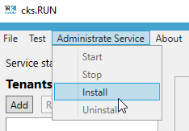
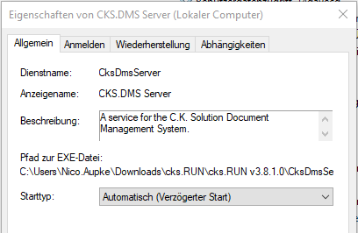
cks.RUN
Installation:
Download corresponding cks.RUN version (database version)
Execute the self-extracting file and select folder structure
Execute the "CksDmsServiceManager.exe" file
In cks.RUN install the service > Administrate Service > Install
Configure the installed service.

Slide 7
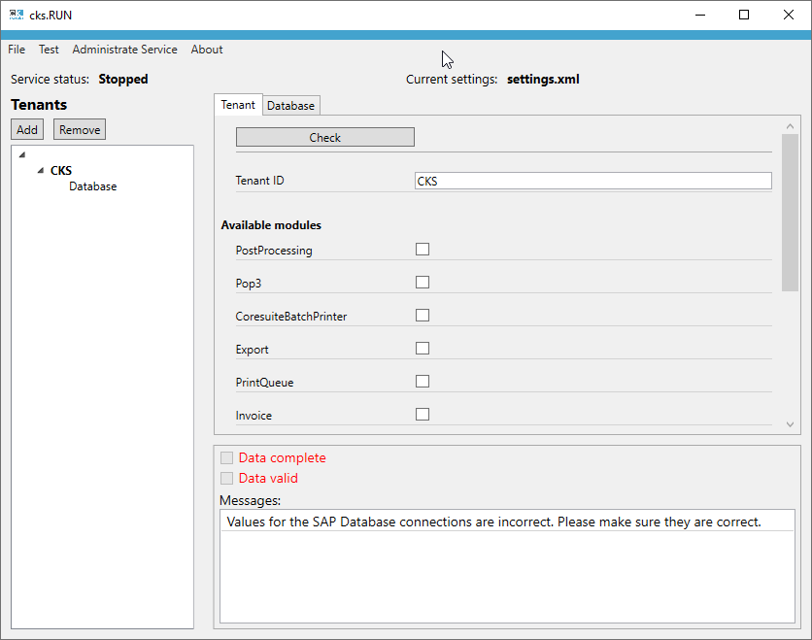
cks.RUN
Structure:
Ribbon:
File: Config Save / Load
Test: Test current configuration
Administrate Service: Install / Uninstall Service
About: Version information
Service status: Current status of the service
Tenants: Which tenants / functions are active
Module activation
Verification functions

Slide 8
cks.RUN
Structure:
Ribbon:
File: Config Save / Load
Test: Test current configuration
Administrate Service: Install / Uninstall Service
About: Version information
Service status: Current status of the service
Tenants: Which tenants / functions are active
Module activation
Verification functions

Slide 9
cks.RUN
Structure:
Ribbon:
File: Config Save / Load
Test: Test current configuration
Administrate Service: Install / Uninstall Service
About: Version information
Service status: Current status of the service
Tenants: Which tenants / functions are active
Module activation
Verification functions

Slide 10
cks.RUN
Structure:
Ribbon:
File: Config Save / Load
Test: Test current configuration
Administrate Service: Install / Uninstall Service
About: Version information
Service status: Current status of the service
Tenants: Which tenants / functions are active
Module activation
Verification functions

Slide 11
cks.RUN
Structure:
Ribbon:
File: Config Save / Load
Test: Test current configuration
Administrate Service: Install / Uninstall Service
About: Version information
Service status: Current status of the service
Tenants: Which tenants / functions are active
Module activation
Verification functions

Slide 12
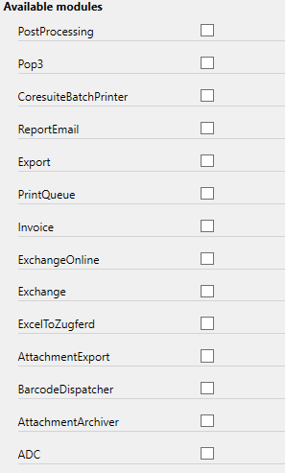
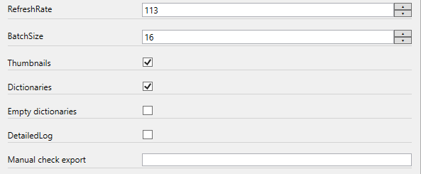
cks.RUN
Module:
PostProcessing:
Checks the linked archive database (internal or external) for,
whether thumbnail / dictionaries are empty. If yes = create new.

Slide 13
cks.RUN
Module:
Exchange Online / Exchange:
Automatically retrieve email mailboxes.
Common processes:
Outgoing / Out.- Have incoming documents processed directly.
Pick up incoming documents directly and send them to the inbox for further processing

Slide 14
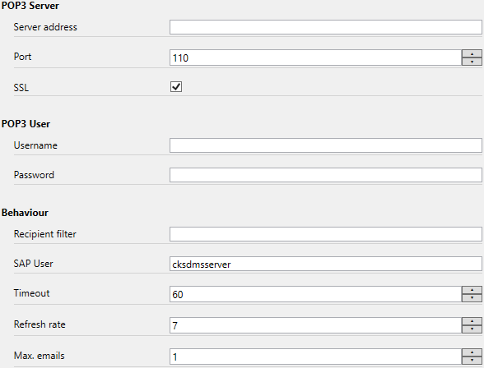
cks.RUN
Module:
POP3:
Fetching and automatic archiving of a POP3 mailbox.

Slide 15
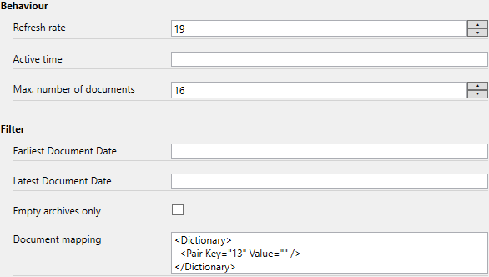
cks.RUN
Module:
PrintQueue:
Module to be prepared for Coresuite Batchprint / Service and Invoice module.
This defines which document types belong in the print queue:

Slide 16
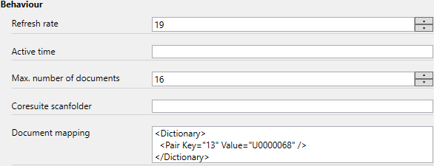
cks.RUN
Module:
Coresuite Batchprint / Service:
Passes the data of the PrintQueue to the Coresuite batch print with the corresponding
print definition.

Slide 17
cks.RUN
Module:
Invoice:
Automation cks.EINVOICE Modul:
Creating the XInvoice / ZUGFeRD file
Storage of the XInvoice in a defined path
Sending the documents via SMTP
Attention: If "Export path" is empty, the system assumes,
that the documents will be sent via SMTP.

Slide 18
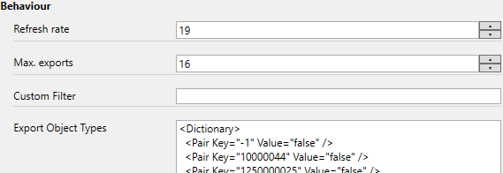
cks.RUN
Module:
Export:
Time-controlled export of archive entries:
To a target directory with definable file names
Into an external database (stored procedure)

Slide 19
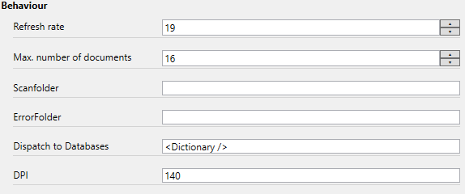
cks.RUN
Module:
Barcode Dispatcher:
Automatic assignment of documents to different SAP clients :
Third party system generates e.g. PDF documents which have to be moved to different databases.
Example:
- SAP Database A: Präfix CKS
- SAP Database B: Präfix ABC

Slide 20
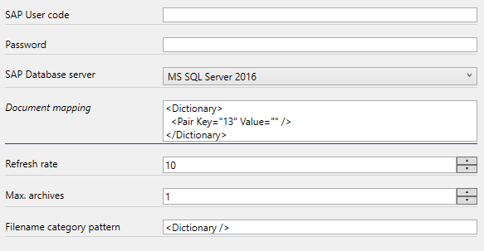
cks.RUN
Module:
AttachmentArchiver:
Automatically archive attachments.

Slide 21
cks.RUN
Module:
ADC:
Full automation of the ADC Process:
Folder monitoring
Email mailbox monitoring
Exchange
Exchange Online
POP3
Advantages :
CPU / RAM load is not utilized on the client side
No manual profile selection necessary

Slide 22
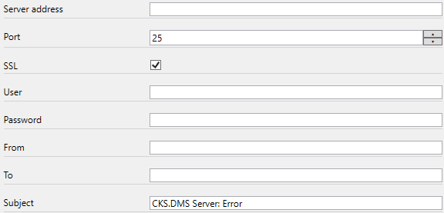
cks.RUN
Module:
ReportEmail:
As soon as the cks.RUN detects an error, an error report is automatically sent to the specified e-mail address.
an error report is automatically sent to the specified e-mail address.

Slide 23
cks.RUN
Update:
Following Process:
Download the latest version of cks.RUN
Copy Settings.xml file from the old folder to the new one (take over old configuration)
Start new version :
A message appears that the old service is still installed.
Uninstall this version via "Administrate Service" and install the new version.
Set the Windows service to "Delayed start" again.

