Slide 1
Nico Aupke
Project management / support management
C.K. Solution
Nico.Aupke@cksolution.de

Slide 2
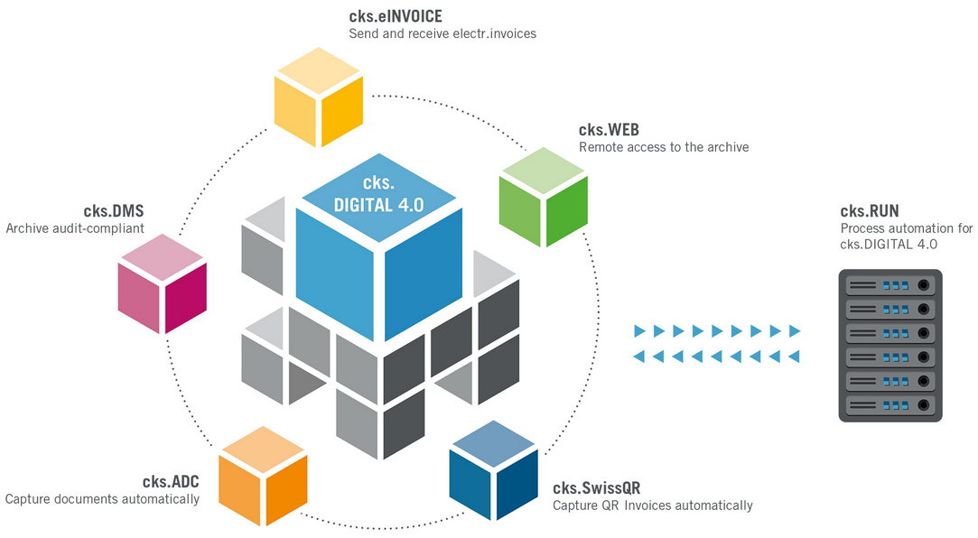
Course structure
The structure:
- cks.DIGITAL 4.0
- cks.DMS
- cks.ADC
- cks.RUN
- cks.WEB
After that online course exam

Slide 3
cks.ADC
Abbreviation:
ADC = Automatic Document Capture
Basic functions:
- Automatic processing of documents (PDF / TIF files)
- Multiple document types are supported
- Full validation capabilities of recognized values
- Complete overview of inbound processes (including SAP approval process)

Slide 4
cks.ADC
What must be agreed upon in advance:
A project manager is required on the customer side.
Complete access to the server landscape is required.
cks.DIGITAL 4.0 and cks.DMS package must be installed (partner side).
Scheduling kick-off meeting (customer / partner / ck.solution)
Important: cks.ADC introductions can be considered a "small" project!

Slide 5
cks.ADC
How is a project designed?:
- Before the start of the project (sales phase):
- First process is presented.
Analysis of the top 10 suppliers (feasibility study).
Project start (project phase):
- Kick-off meeting
- Installation phase
- Setup phase
- Training / Handover
- GoLive

Slide 6
cks.ADC

Slide 7
cks.ADC
Installation cks.ADC:
cks.DIGITAL 4.0 / cks.DMS must be installed (partner side)
cks.ADC must be installed:
Server side:
- ToolKit in the latest version
- VSTA
- LicenseCenter
Client side: (In advance it must be clarified which clients want to use the ADC)
- ToolKit in the newest version
- VSTA

Slide 8
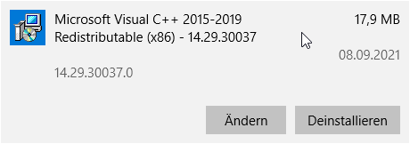
cks.ADC
Installation ToolKit / VSTA:
In advance:
- Microsoft Visual C++ >= 2015 (32 bit) must be uninstalled
- .NET Framework 2.0 is also installed (This may have to be done manually)
Installation routine:
- Installation ToolKit
- Installation VSTA

Slide 9
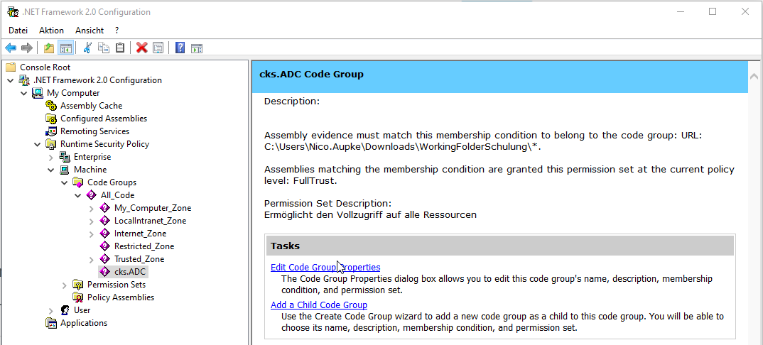
cks.ADC
Configuration .NET Framework 2.0:
Here the WorkingFolder path must be defined in
the .NET Framework 2.0 must be defined.
Important: Under HANA, the WorkingFolder must not be placed
be placed in the B1_SHR folder. (Permissions)
Tip: Can also be entered via the command line:
%SystemRoot%\Microsoft.NET\Framework\v2.0.50727\caspol -m -addgroup 1 -url [Pfad zum WorkingFolder]\* FullTrust -name "cks.DMS ADC"

Slide 10
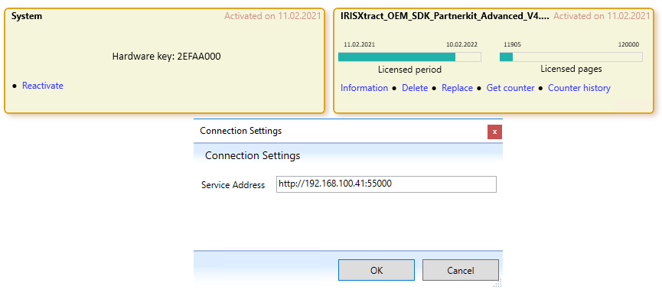
cks.ADC
Serverside:
Installation LicenseCenter
A Windows service is created in the background,
which must be started manually.
After that the system / license must be activated
this is done by ck.solution.
Tip: The system is hardware dependent! If changed, the system is blocked and must be reactivated.

Slide 11
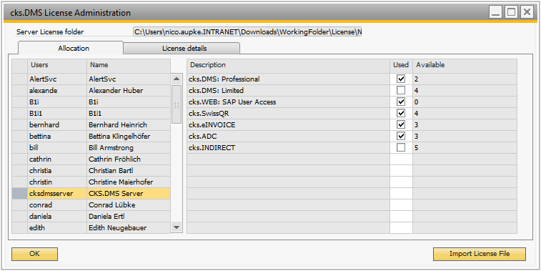
cks.ADC
License management:
Administration > License > cks.DMS License Administration
With the delivery of the license 10 cks.ADC
user licenses are delivered with the license.
Assignment via license Administration.

Slide 12
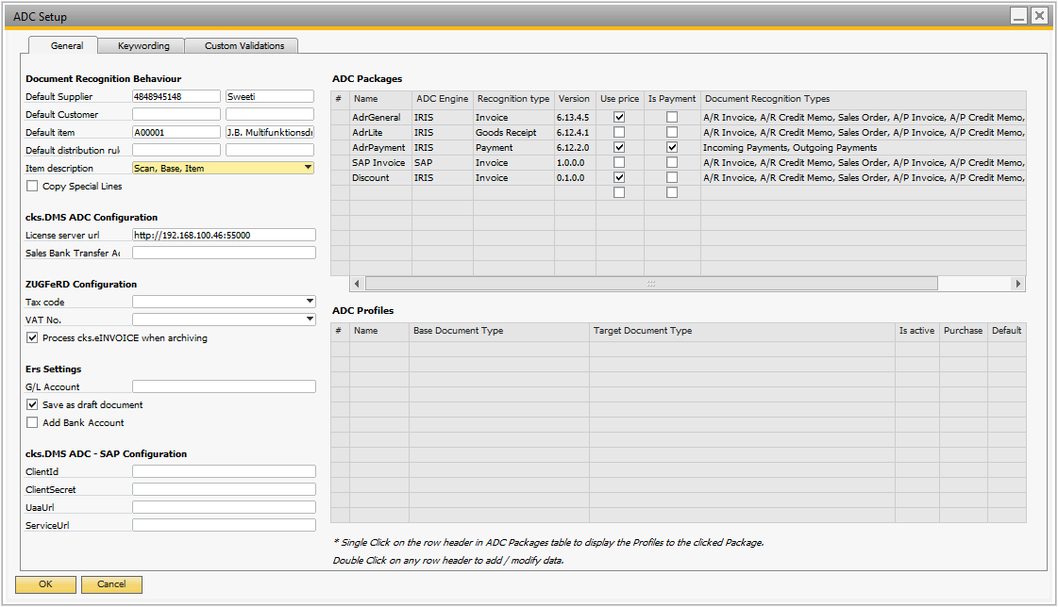
cks.ADC
Pre-Configuration:
Global Configuration
Administration > Add-ons > cks.DMS Configuration > ADC
Mandatory fields :
Standard supplier
Standard article
License server url

Slide 13
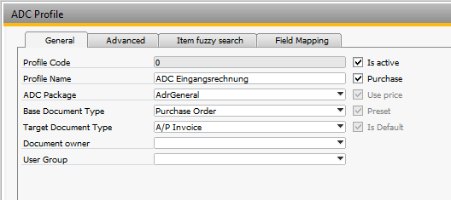
cks.ADC
Packages and Profiles:
ADC Packages:
Recognition logics
Separation of invoices and e.g. delivery bills (General / Lite Package)
ADC Profile:
Setting base / target document
Fuzzy search activation
UDF field assignment (mapping)

Slide 14
cks.ADC
Keywording:
Configuration across all business partners / override SAP B1 default behavior.
Marriage of a term with SAP master data:

Slide 15
cks.ADC
Custom Validations:
General Information:
Checks are defined using SQL queries.
https://www.cksolution.de:/intern/Manuals/EN/register-individuelle-pruefung.html
Status Validations:
Here you can see directly at first glance whether a validation has failed and manual intervention is required.
must be done.

Slide 16
cks.ADC
Custom Validations:
Value Validations:
Here, recognized values are validated with SAP master transaction data. Example: Quantity / price differ between base and target document.

Slide 17
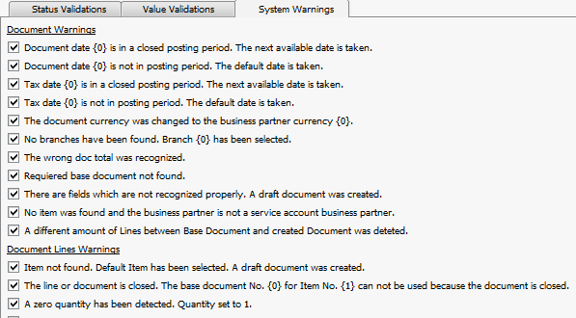
cks.ADC
Custom Validations:
System Warnings:
System checks, which are active by default. These can be enabled / disabled as needed:

Slide 18
cks.ADC
Business partner identification:
BP-Name
VAT Number
IBAN
Adress
SearchTerm

Slide 19
cks.ADC
Line determination:
- The following criteria must be met (in the standard package)
- Line must be at least single price x quantity = total line price (difference of 5 cents possible)
- Line may be max. 3 lines apart

Slide 20
cks.ADC
Basic document determination :
Global definition. (Example: Order)
GP setting. (e.g. DocNum)
In this way, all open orders are determined for the document recognition and the base document is determined on the basis of the DocNum (which must also be on the invoice).

Slide 21
cks.ADC
Base line determination :
Now that the base document has been determined, the lines must be "married". There are several conditions for this:
Determination:
Quantity and price between order line and invoice line is the same.
Article number / BP- KatNum etc. are on the invoice and in SAP B1.
If several same article numbers are found = quantity and / or price
is added.

Slide 22
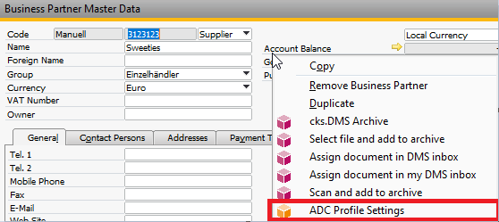
cks.ADC
Business Partner ADC- Profil Settings:
Find in: Business Partner Master Data > Right Click > ADC-Profil Settings

Slide 23
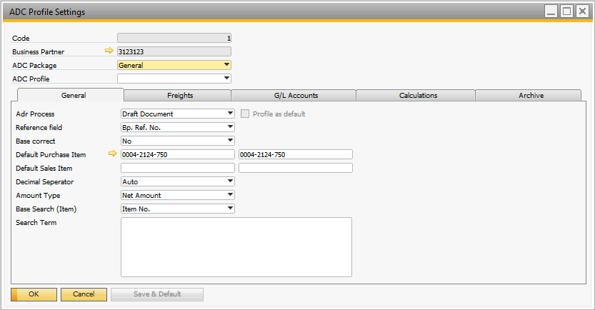
cks.ADC
Business Partner ADC- Profil Settings:
Divided into the following 4 tabs :
General
Freights
G/L Accounts
Calculations
Archive

Slide 24
cks.ADC
Tab General:
Basically relevant settings:
- ADC process
- Base correct
Reference field
Search Field

Slide 25
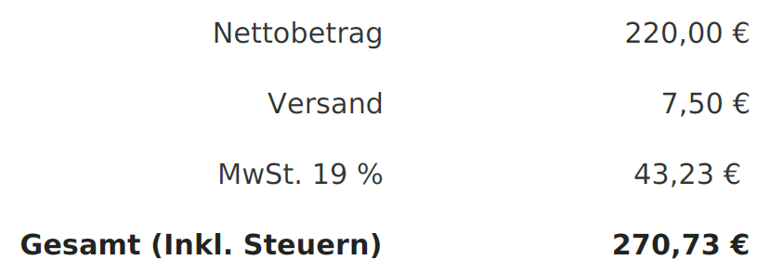
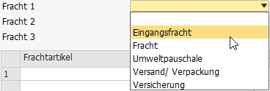
cks.ADC
Tab Freights:
Differentiation between footer and line loads.
Footer freights:
Representation of the freights in the total block of the invoice

Slide 26
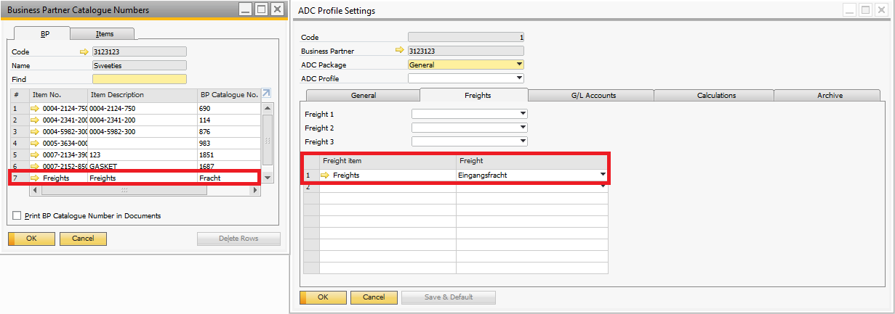
cks.ADC
Tab Freights:
Differentiation between footer and line loads.
Line freights:

Slide 27
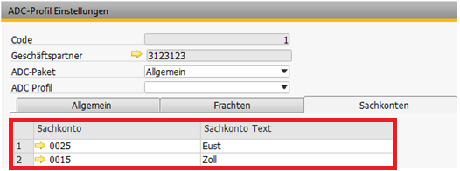
cks.ADC
Tab G/L Accounts:

Slide 28
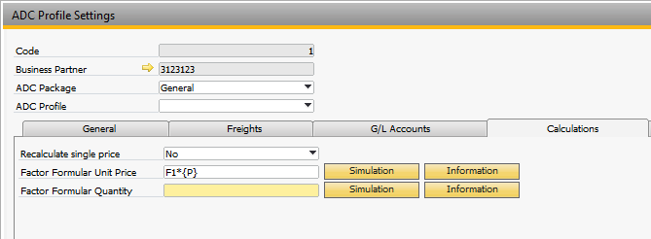
cks.ADC
Tab Calculations:
New calculation of unit prices and quantities based on SAP B1 factors.

Slide 29
cks.ADC
Tab Archive:
Direct assignment between business partners and Users (Usergroups).

Slide 30
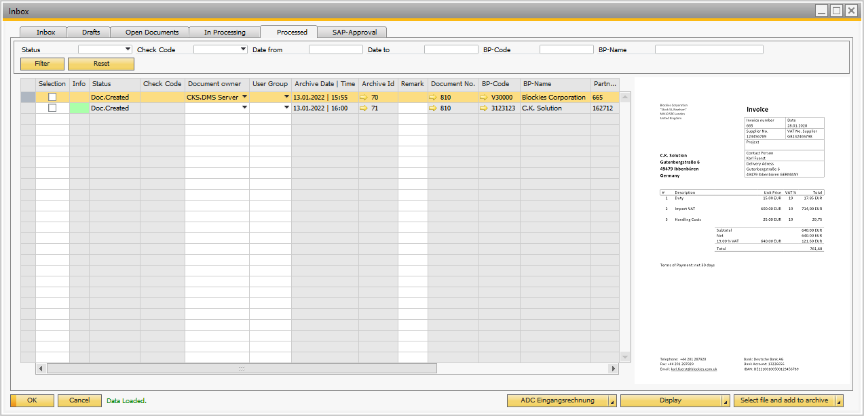
cks.ADC
Process:
Document is placed in the inbox.
Document recognition is started.
Posting is created.

Slide 31
cks.ADC
Train the Supplier invoice:
In the draft > Tools > ADC Recognition Correction
This opens a window where fields can be trained:

Slide 32
cks.ADC
Full automation
Full automation is possible with the cks.RUN:
- E-mail collection
- Folder monitoring
- Hybrid function

